Slide 1
Malayalam Parser for Dataset Creation
Abstract Presentation
Guided by:
Dr. Mary Priya Sebastian
Fathima Jennath N K
Gautham C Sudheer
Godwin Gino
Mohammed Basil

Slide 2
Contents
Introduction
Description of Project
Scope of the Project
Functional Requirements of the Product
System Features
Software/Hardware Requirements
Conclusion

Slide 3
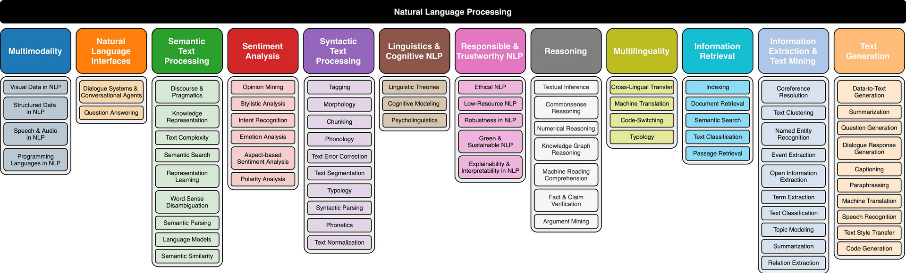
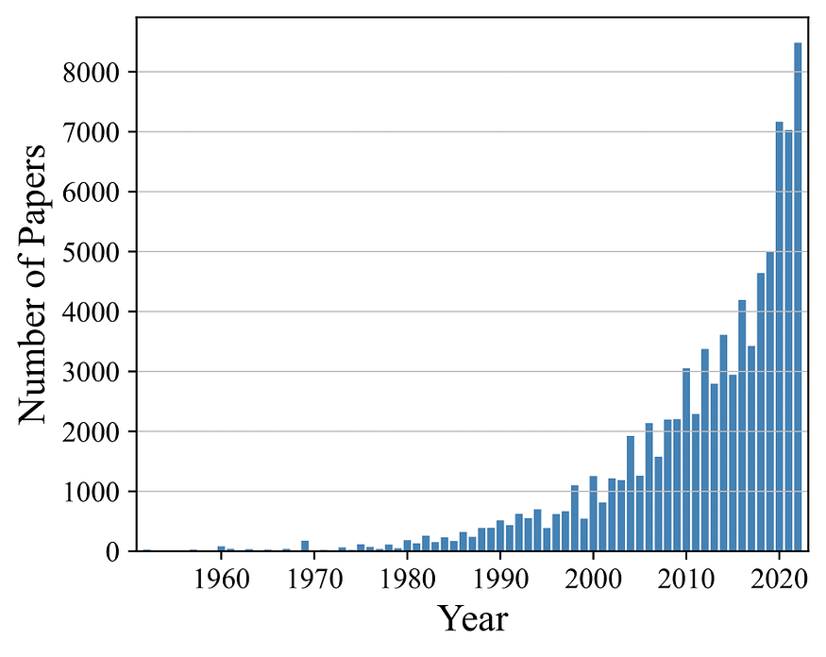
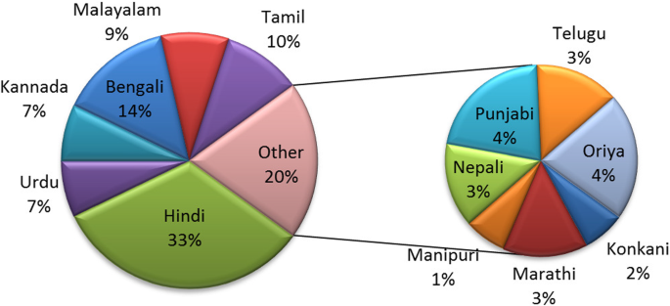
Notes:
https://towardsdatascience.com/a-taxonomy-of-natural-language-processing-dfc790cb4c01
https://link.springer.com/article/10.1007/s10462-018-9670-y

Slide 4
Introduction
Importance of Natural Language Processing (NLP) in regional languages
Focus on the specific relevance of Malayalam in the context of NLP applications.
Challenges associated with the scarcity of annotated datasets.
Analyze both the syntactic and semantic structures of Malayalam sentences
Applications such as sentiment analysis, named entity recognition, etc.
Potential impact on advancing research and applications specific to the Malayalam
Notes:
Mention the relevance of the domain of the project.
Give brief introduction related to your application.
Highlight the need of your application
Maximum 1 slide with 4 or 5 bullet points need to be mentioned.

Slide 5
Description of Project
To create a Malayalam Parser for dataset creation, involving data collection, preprocessing, manual annotation, and training using various parsing approaches to address the scarcity of annotated datasets in Malayalam for NLP applications.
Notes:
Describe the work you are going to implement in a single/two lines
Example 1 – To develop a software for content summarization using NLP techniques, which can support applications in the field of education and research.
Example 2 – To design, develop and implement a multimodal transport app for Kochi.

Slide 6
Scope of the Project
Address the scarcity of annotated datasets in the Malayalam language for Natural Language Processing (NLP) applications.
Analysis of grammatical structures in Malayalam text data.
Contributing to the overall improvement of Malayalam language processing technologies.
Does not include specific application development for sentiment analysis, named entity recognition, or machine translation.
Notes:
Mention the scope of the project.
Mention clearly what all aspects are covered in your project.
This input is necessary to understand what will not be available in your software.

Slide 7
Functional Requirements
Parse and analyze Malayalam language text to identify linguistic components such as words, phrases, and sentences.
Determine grammatical structure, syntax, and semantics of Malayalam sentences to facilitate accurate linguistic analysis.
Provide functionality for part-of-speech tagging, syntactic parsing, and semantic analysis tailored for the Malayalam language.
Notes:
Add Functional Requirements from your SRS
Consolidate to maximum of 2 slides

Slide 8
Functional Requirements
Support for handling compound words, inflections, and variations in word forms commonly found in Malayalam text.
Generation of a part-of-speech tagged dataset, named entity dataset, and sentimental tagged dataset, contributing to the advancement of language processing technologies in Malayalam
Implement a user-friendly interface that allows users to input Malayalam text for analysis
Notes:
Add Functional Requirements from your SRS
Consolidate to maximum of 2 slides

Slide 9
System Features
Text Parsing: The parser breaks down Malayalam language text into its constituent components such as words, phrases, and sentences.
Lemmatization and Morphological analysis: Identifying the base forms of words and analyzing word forms to determine grammatical properties in Malayalam text .
Dependency Parsing: Identifying the syntactic dependencies between words in a Malayalam sentence.
Notes:
Bullet points for features offered by your product/ project/ web app / android app
One line description for one feature.
Maximum 3 slides

Slide 10
System Features
Semantic Analysis: The system determines the meaning and interpretation of Malayalam text, capturing semantic relationships between words and phrases.
Part-of-Speech Tagging: Each word in a Malayalam sentence is assigned appropriate part-of-speech tags, indicating its grammatical function.
Syntactic Parsing: It analyzes the syntactic structure of Malayalam sentences, identifying constituents and their hierarchical relationships.
Error Handling: Mechanisms are in place to detect and handle errors or inconsistencies in input Malayalam text, ensuring parsing reliability.
Notes:
Bullet points for features offered by your product/ project/ web app / android app
One line description for one feature.
Maximum 3 slides

Slide 11
Software / Hardware Requirements
Windows 10 or later
MacOS 10.13 High Sierra or later
Ubuntu 18.04 LTS or later
A modern processor (e.g., Intel Core i5 or equivalent)
Sufficient RAM (at least 4GB)
Available storage space for software installation
Python (version 3.6 or later)
Other programming languages and frameworks suitable for NLP development like NLTK, spaCy, scikit-learn, TensorFlow, etc. may be necessary
Notes:
List the Software to be used in your project
List the Hardware (needed to run your project/ specifications of the PC in which you can run the product)

Slide 12
Conclusion
A comprehensive Malayalam language processing tool facilitating accurate linguistic analysis and dataset generation for NLP applications.
Parsing and analysis of Malayalam text, enabling identification of linguistic components and determination of grammatical structure, syntax, and semantics
Generates part-of-speech tagged, named entity, and sentiment-tagged datasets
Contribute significantly to the advancement of language processing technologies in Malayalam.

Slide 13
Thank you

